Slide 1



(Blood Bank)
HealthCare Management System
DS5110: Final Project
Naga Pavithra Lagisetty
Sunkara Vinisha
Roshitha Tiruveedhula

Slide 2

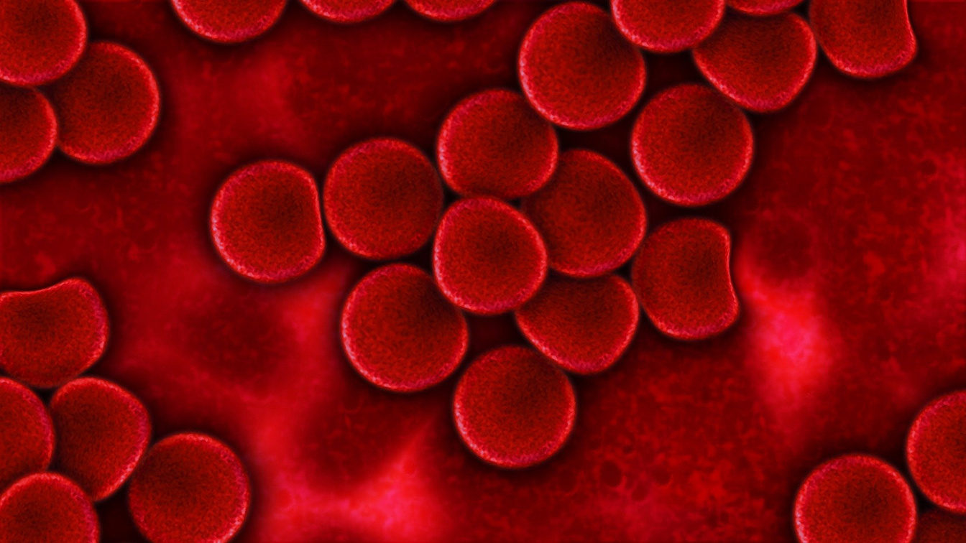
Introduction

Slide 3

Objectives and Goals
Objectives
To develop the Predictive Models for Donor Eligibility.
Provide easy access to find donors and nearby blood banks.
Improve emergency responsiveness in blood donation.
To build an interactive dashboard for blood donation users.
Goals
Deliver a solution that benefits both the donors and receivers.
Include various data preprocessing and data visualization techniques.
To use Advanced Machine Learning models for prediction.

Slide 4

Project Scope
Using historical data of blood donations that includes frequency of donation, blood group, time since the first and last donation, number of units of blood donated.
Preprocessing the data by cleaning, handling missing values and removing the outliers.
Visualizing the key metrics and insights of the data.
Building machine learning models for prediction.
To build a dashboard to manage donor registration, blood donation tracking, and eligibility verification.
To Enhance the response time to urgent requirement.

Slide 5
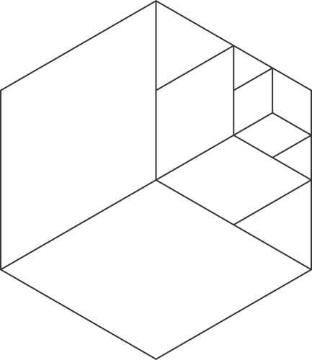
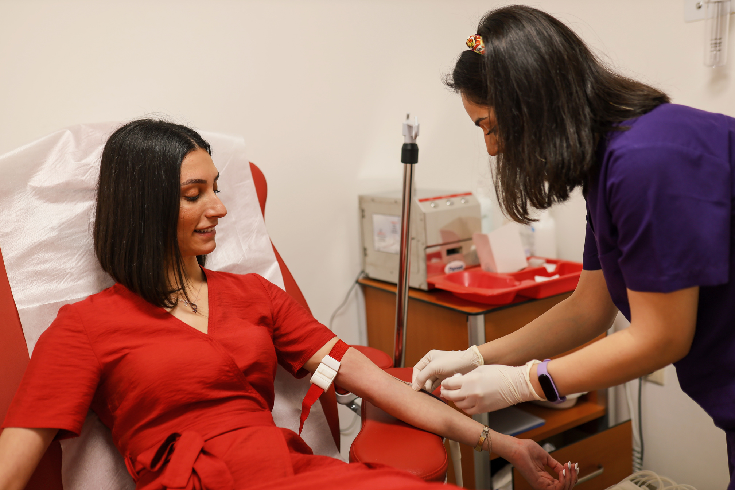
Literature Review
Existing works includes using basic Machine Learning algorithms to predict the donor eligibility based on health and donation history.
Lack of comprehensive integration between donor systems and hospital transfusion systems.
Balancing supply and demand is complex due to the perishable nature of blood. AI-driven forecasting models help predict demand accurately.

Slide 6

Integrating hospital records with blood bank systems remains a challenge. Effective data cleaning and preprocessing are critical to ensuring accurate analysis.
Missing Aspects of Existing Work
Incorporating a visualization component for critical blood requests for quick identification of urgent needs.
Combined Donor eligibility assessment, Blood bank management and Critical request handling

Slide 7


Methodology
Data Preprocessing
Load and rename columns in the dataset
Data Cleaning:
- Handling missing and duplicates in the data.
- Detect outliers with Z-score and Quantile Range methods
Create new feature: "donation_duration"
Apply Power Transformation for feature scaling using PowerTransformerData Preprocessing
Exploratory Data Analysis
Visualize feature distributions with four different data visualization plots.
Create scatter plots to explore relationships between variables
Analyze total blood donated by donor status using box plots

Slide 8
Methodology
Model Selection
Feature Engineering (categorial -> numerical)
Use cross-validation with StratifiedKFold
Different Machine Learning models like:
Logistic Regression
Random Forest (combining multiple decision trees)
Gradient Boosting
Support Vector Machine
Comparing the models based on Average AUC scores
Evaluation of the Models(Metrics)

Slide 9
Methodology
Hyperparameter Tuning
Utilize Optuna for hyperparameter optimization
Focus on tuning CatBoost parameters
Define objective function for optimization
Employ Stratified K-Fold cross-validation during tuning
Use pruning to eliminate unpromising trials early
Final Model Evaluation
Split data into training and test sets using train_test_split
Train the selected model
Evaluate model performance on test set using AUC score
Prepare results dataframe with true labels and predicted probabilities
Consider using SHAP values for model interpretability (mentioned in imports)

Slide 10
Methodology
Dashboard
Used Streamlit to build an interactive dashboard.
The dashboard tells about
Donor management
Blood-bank management
Finding donors from different cities
Blood Requests
Checking the eligibility of donation of an user.
The dashboard also displays about emergency requirement.

Slide 11
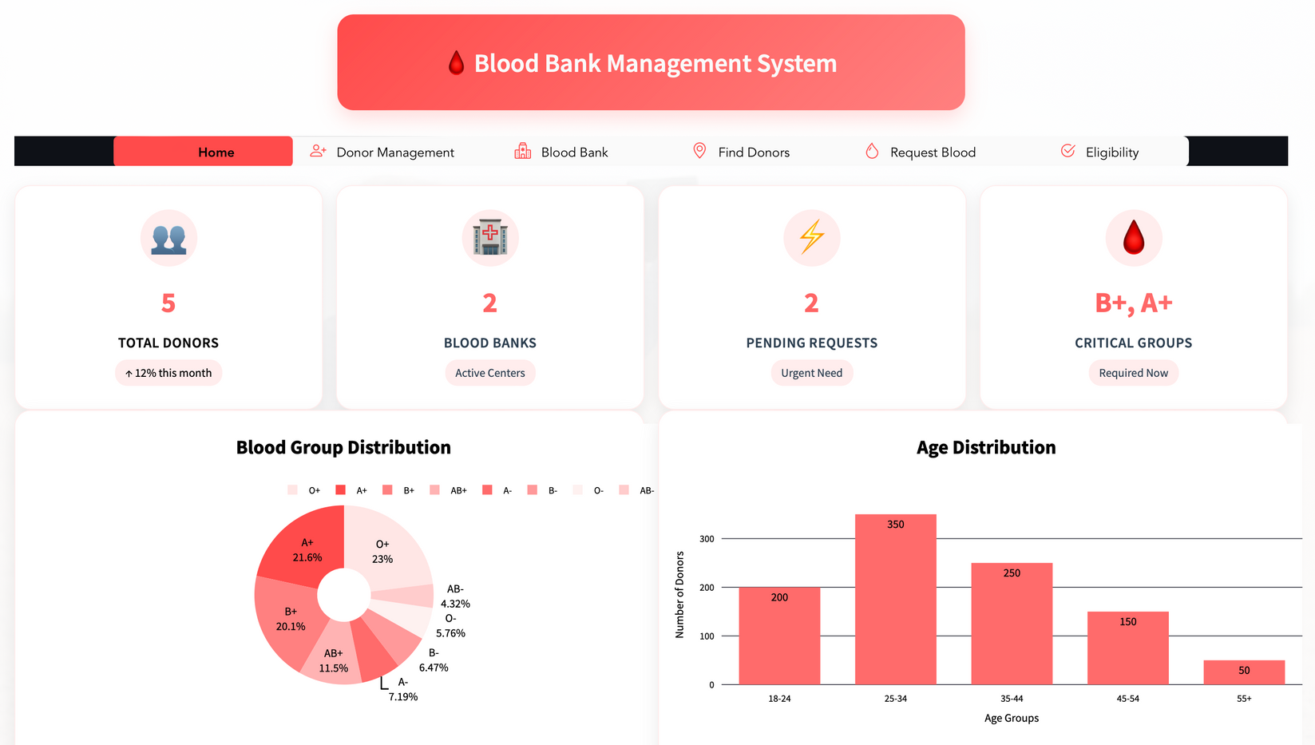
Data Visualization
Demo

Slide 12
Logistic Regression is the superior model for this blood donation eligibility prediction task, primarily due to its significantly higher AUC score.
Key Findings
The higher AUC score (0.7987) of Logistic Regression suggests it has better discrimination power between donors and non-donors compared to Random Forest.
Multiple machine learning models were evaluated, including Logistic Regression, Random Forest, Gradient Boosting and SVM. This comprehensive comparison allows for selecting the best-performing model.

Slide 13
Optuna was used for hyperparameter optimization, focusing on the CatBoost model. This suggests a commitment to maximizing model performance through fine-tuning.
Key Findings
The code converts features to string type and uses categorical indices, indicating proper handling of categorical variables, especially for tree-based models like CatBoost.
Stratified K-Fold cross-validation was used, ensuring that the model's performance is evaluated consistently across different subsets of the data.

Slide 14
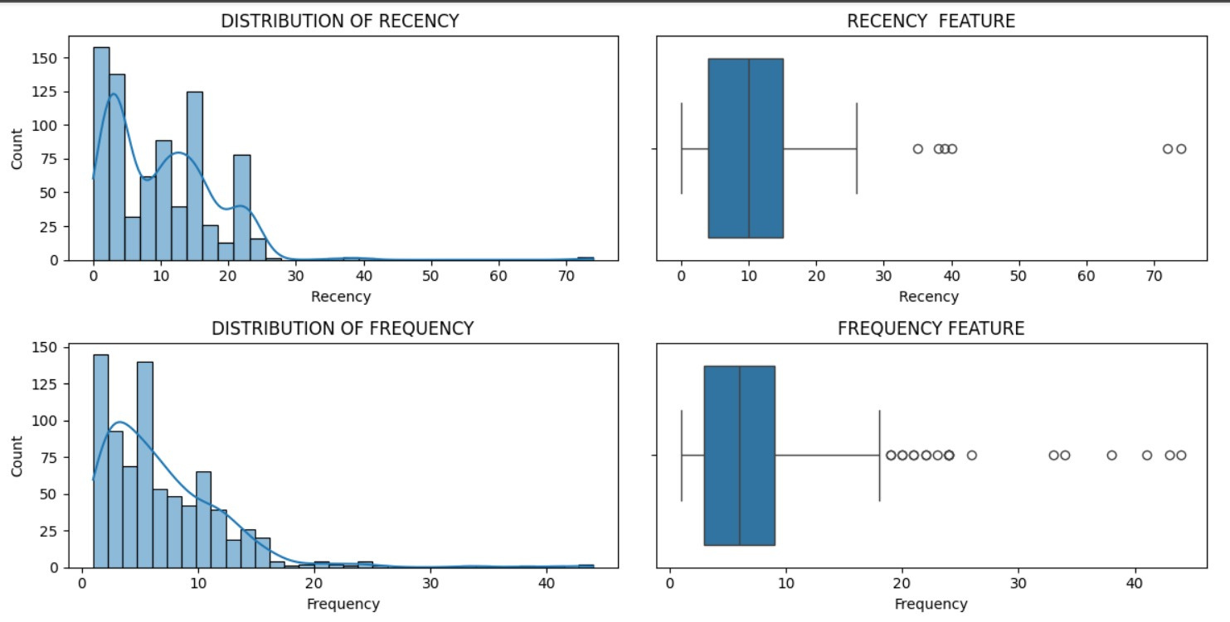
Visualizations

Slide 15
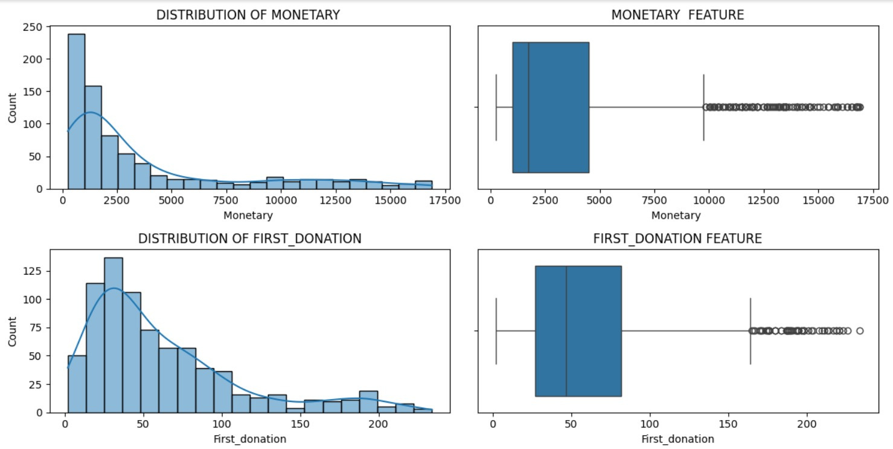
Visualizations

Slide 16
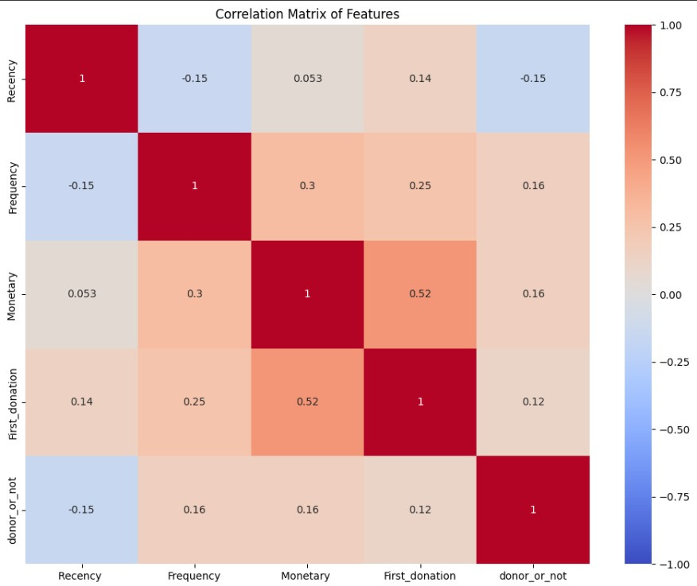
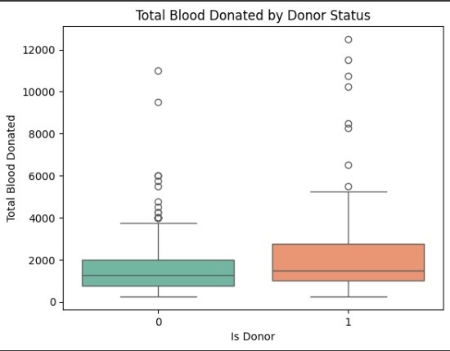
Visualizations
Box Plot
Correlation Matrix

Slide 17
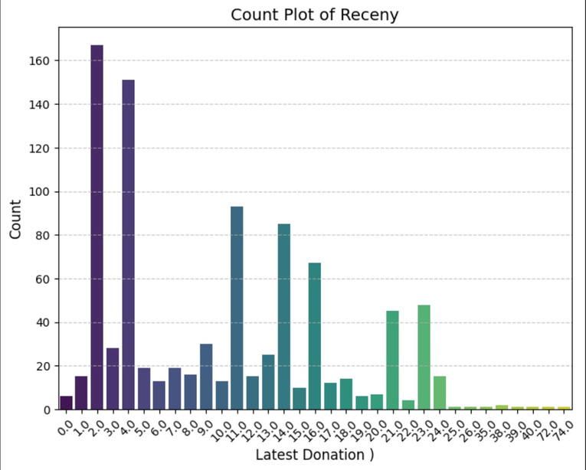
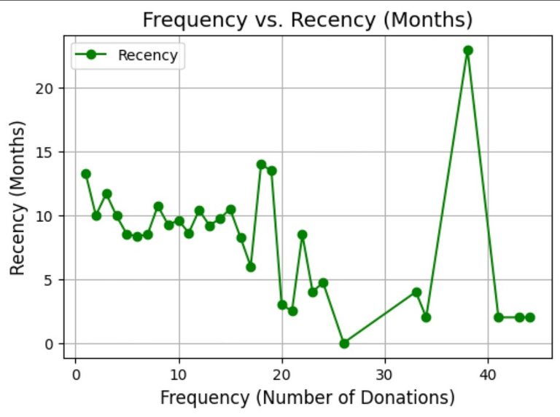
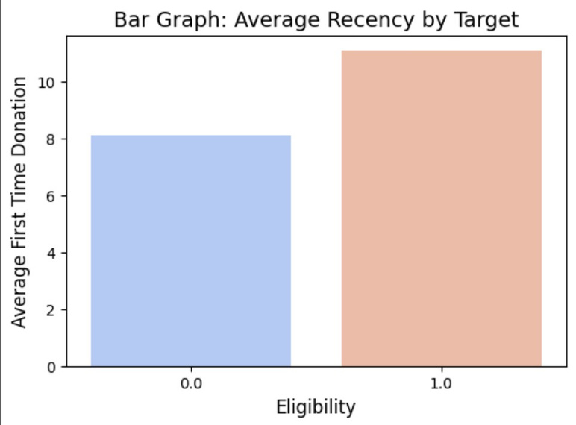
Visualizations
Count Plot
Line Graph
Bar Graph

Slide 18

Interpretation of Results
Model name | Training accuracy | Testing accuracy
Logistic regression | 0.76 | 0.8
SVM | 0.75 | 0.78
Gradient Boosting | 0.76 | 0.79
Random forest | 0.79 | 0.73
Performance of Logistic regression was better as it had higher accuracy
The simpler Logistic Regression model outperforming the more complex Random Forest indicates that the relationship between features and the target variable might be more linear than initially assumed.

Slide 19
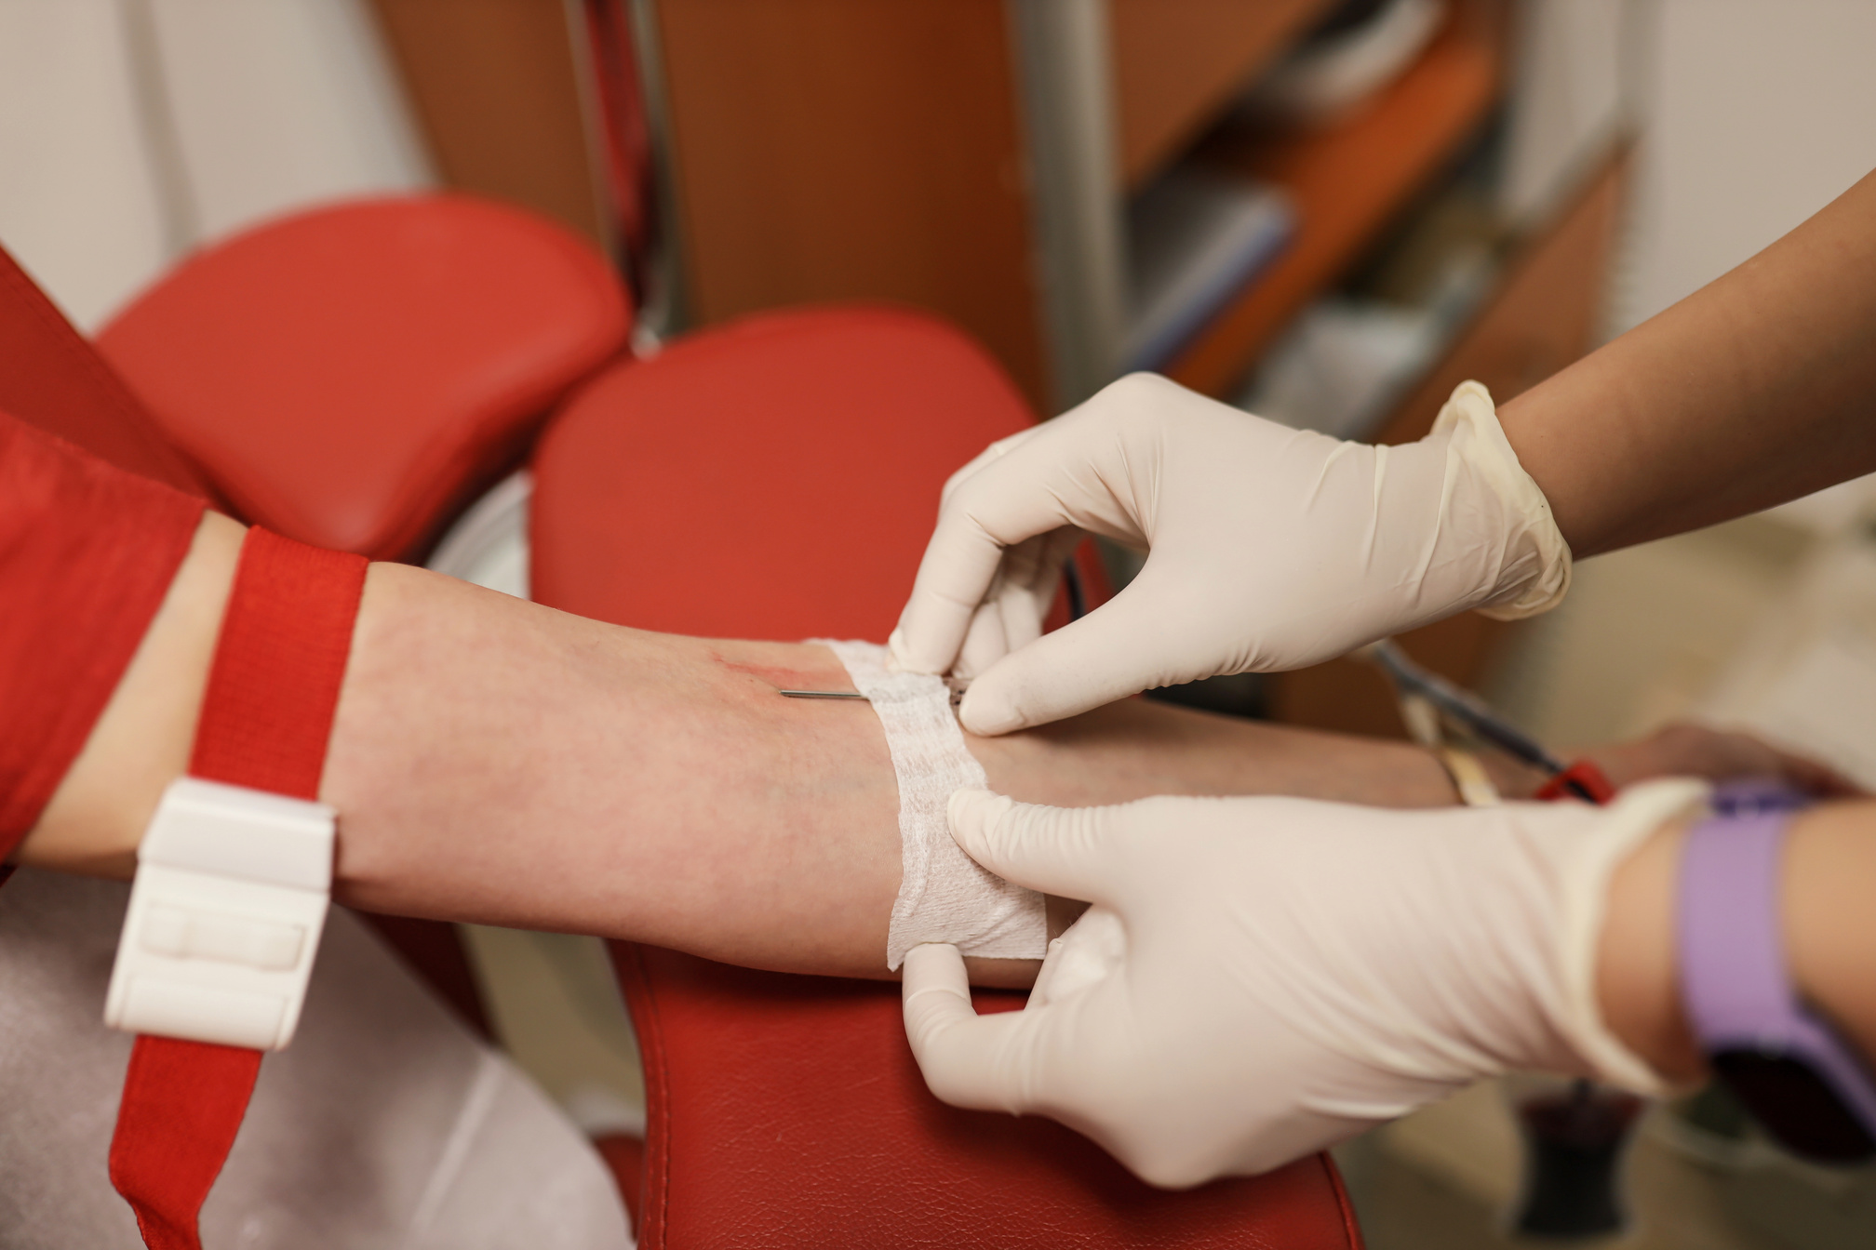
Implication of Findings
Insights can help the campaigns to increase donation rates by addressing eligibility and frequency trends.
Data can help the blood banks maintain the right supply levels, minimizing wastage.
Predictive insights enable efficient planning of blood donation events during high-demand periods.
Visualization of correlation matrix implicates that there is rough correlation between Recency and Frequency.
Results help to ensure safe and sufficient blood supplies, ultimately improving emergency response and healthcare outcomes.

Slide 20

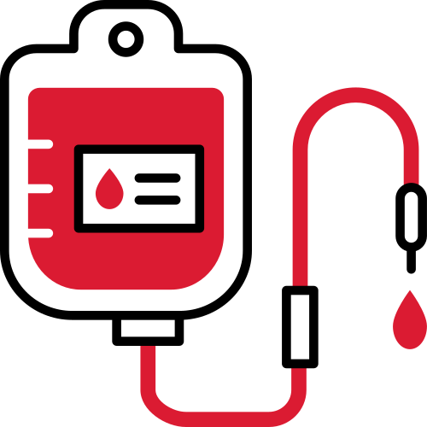
Project Limitations
Limited access to comprehensive and real-time blood donation data.
Donor eligibility and availability can change due to unforeseen health or situational factors, making predictions less robust.
Ensuring donor privacy and compliance with data protection laws can limit data usage and sharing.
People’s willingness and eligibility to donate blood can vary based on personal, social, or health factors, making it difficult to predict with high certainty.

Slide 21

Conclusion
Integrated machine learning with Streamlit, enabling an interactive and user-friendly interface
Logistic Regression yielded the best results across all the models.
Creating the donation_duration feature as the difference between first_donation_months and last_donation_months added valuable domain-specific insight to the dataset
The dual use of Z-score and quantile range methods for outlier detection ensured robust preprocessing.
The use of transformation normalized the dataset.

Slide 22

Future Scope
Incorporate real-time data from donation centers and mobile blood banks to enable dynamic forecasting and proactive responses
Enhance prediction accuracy by integrating more deep learning models or ensemble methods.
Develop systems that automatically suggest when and where donors should be contacted for donation drives based on their historical data, preferences, and local needs.
Sending an emergency alert message for donors, when there is an emergency request.

Slide 23

References
T. Jaiswal, S. Singhal, J. N. Singh and S. Singh Yadav, "Blood Donation System," 2022 4th International Conference on Advances in Computing, Communication Control and Networking (ICAC3N).
W. B. Zulfikar, Y. A. Gerhana and A. F. Rahmania, "An Approach to Classify Eligibility Blood Donors Using Decision Tree and Naive Bayes Classifier," 2018 6th International Conference on Cyber and IT Service Management (CITSM).
M. Kaur et al., "A Web-based Blood Bank System for Managing Records of Donors and Receipts," 2022 International Conference on Computational Intelligence and Sustainable Engineering Solutions (CISES).
P. A. J. Sandaruwan, U. D. L. Dolapihilla, D. W. N. R. Karunathilaka, W. H. Rankothge and N. D. U. Gamage, "Towards an Efficient and Secure Blood Bank Management System," 2020 IEEE 8th R10 Humanitarian Technology Conference (R10-HTC).
B. Qiao, Z. Zhou, H. Yang, and J. Cao, “Bird species recognition based on SVM classifier and decision tree,” in 2017 First International Conference on Electronics Instrumentation & Information Systems (EIIS), 2017, pp. 1–4

Slide 24



